Slide 1
Light as a Wave

Slide 2
Wave Phenomena
The wave nature of light allows us to explain and predict many of its behaviours, including:
  Reflection
  Refraction
  Dispersion
  Diffraction
  Interference
  Polarisation

Slide 3
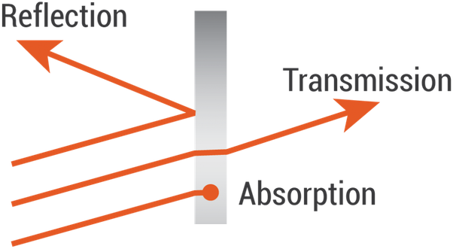
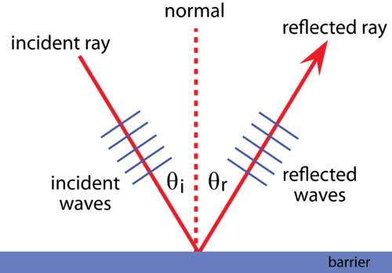
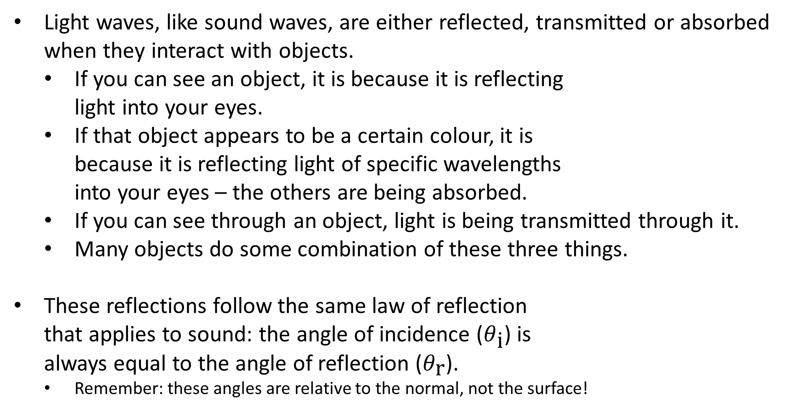
Reflection
Light waves, like sound waves, are either reflected, transmitted or absorbed when they interact with objects.
  If you can see an object, it is because it is reflecting
  light into your eyes.
  If that object appears to be a certain colour, it is
  because it is reflecting light of specific wavelengths
  into your eyes – the others are being absorbed.
  If you can see through an object, light is being transmitted through it.
  Many objects do some combination of these three things.
These reflections follow the same law of reflection
that applies to sound: the angle of incidence ($θ_{\text{i}}$) is
always equal to the angle of reflection ($θ_{\text{r}}$).
  Remember: these angles are relative to the normal, not the surface!

Slide 4
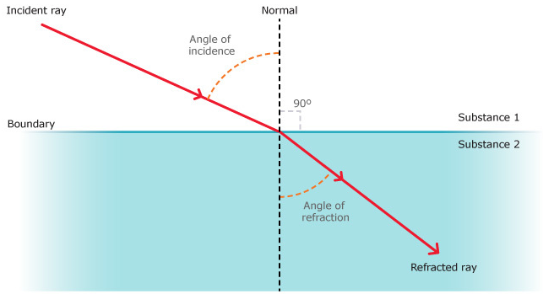
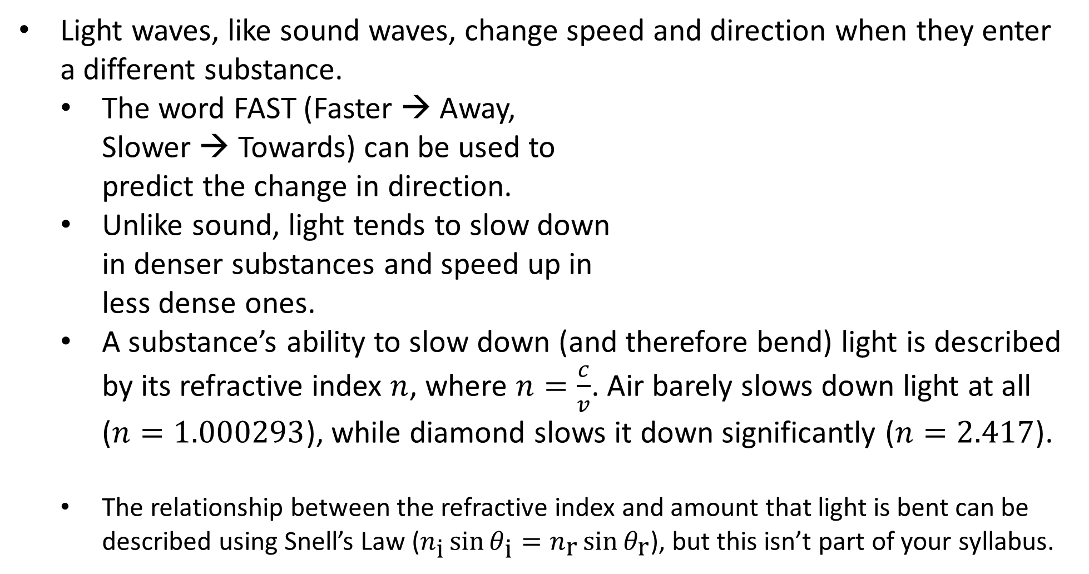
Refraction
Light waves, like sound waves, change speed and direction when they enter a different substance.
  The word FAST (Faster → Away,
  Slower → Towards) can be used to
  predict the change in direction.
  Unlike sound, light tends to slow down
  in denser substances and speed up in
  less dense ones.
  A substance’s ability to slow down (and therefore bend) light is described
  by its refractive index $n$, where $n=\frac{c}{v}$. Air barely slows down light at all ($n=1.000293$), while diamond slows it down significantly ($n=2.417$).
  The relationship between the refractive index and amount that light is bent can be described using Snell’s Law ($n_{\text{i}}\sin{θ_{\text{i}}}=n_{\text{r}}\sin{θ_{\text{r}}}$), but this isn’t part of your syllabus.
Notes:
You also don’t need to know why light slows down or changes direction, but if you’re interested, there are some great videos those two things:
https://youtu.be/CUjt36SD3h8
https://youtu.be/NLmpNM0sgYk

Slide 5
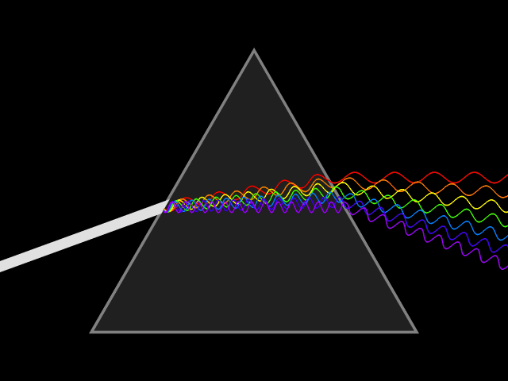
Dispersion
When light is refracted, its frequency remains constant but its velocity and wavelength change.
The refractive index of a material varies depending on the wavelength of the light travelling through it – or, to put it more simply, different colours bend different amounts.
  Specifically, the shorter its wavelength, the more a light wave is refracted.
Because of this, white light – which is a
combination of the entire visible spectrum –
can be separated into its individual colours
when it passes through a transparent material
at an angle. This is called dispersion.

Slide 6
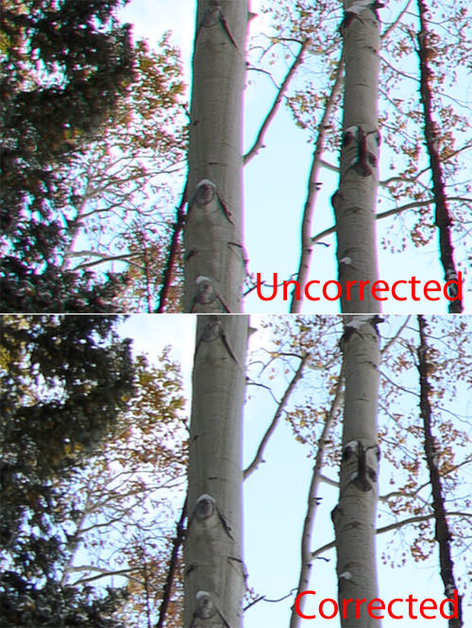
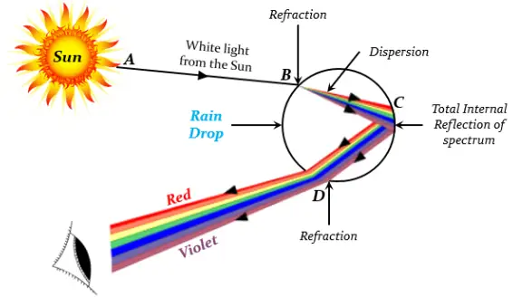
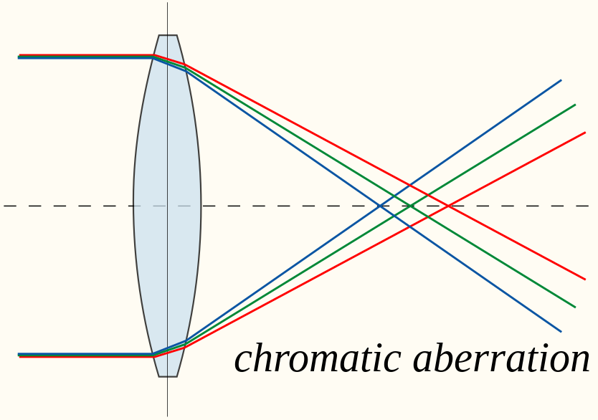
Dispersion
Dispersion (together with reflection) explains
how rainbows form.
It also explains chromatic aberration – the
tendency of low-quality
lenses to produce images
with fringes of colour
around boundaries.

Slide 7
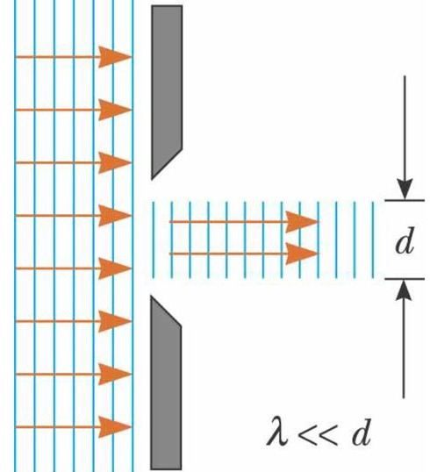
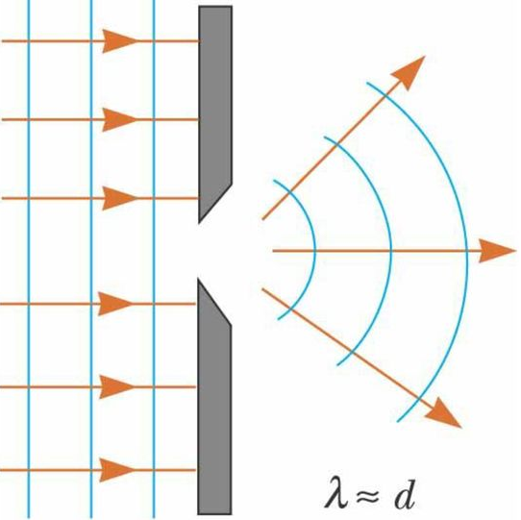
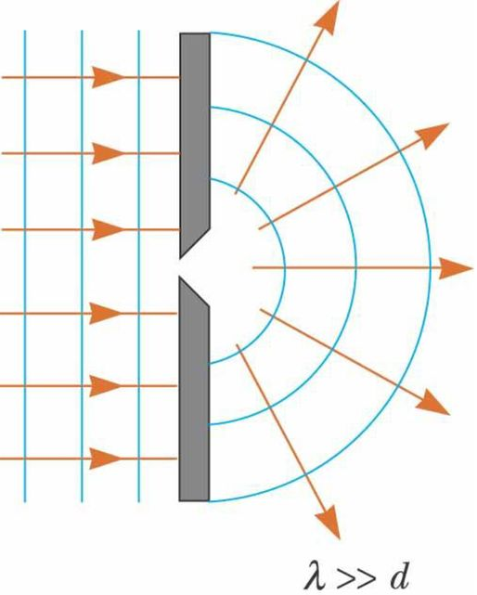
Diffraction
Diffraction is the bending of waves (both sound and light) as they pass the edge of an obstacle or through an aperture (a gap in a barrier).
The amount of diffraction that occurs depends on the wavelength of the wave and the width of the object or aperture. Waves with relatively low wavelengths (high frequencies) diffract very little; waves with approximately equal or relatively high wavelengths (low frequencies) diffract significantly.
Notes:
Again, why this occurs isn’t covered in this course, but if you’re curious, there’s a great video explaining it in terms of the Huygens-Fresnel principle at https://youtu.be/TqTWSSBcV_4, and a helpful written explanation at https://physics.stackexchange.com/questions/125903/why-does-wavelength-affect-diffraction (look at the top answer).

Slide 8
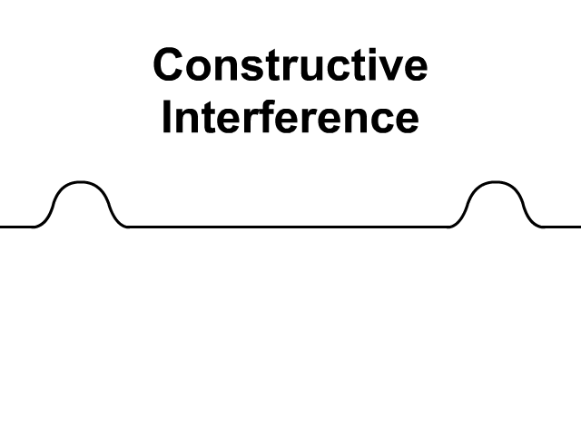
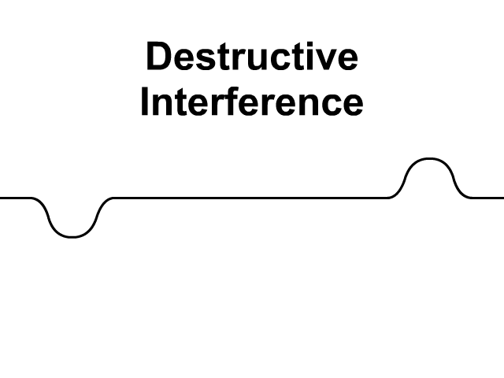
Interference
It is possible for two waves to be in the same region of space at the same time. When this occurs, the resulting wave is the sum of the individual waves. This is the superposition principle.
Interference is a result of superposition. Two waves can either reinforce each other, resulting in a wave of higher amplitude (constructive interference), or counteract each other, resulting in a wave of lower amplitude (destructive interference).
Together, these ideas help explain one of the most important experiments in the history of our understanding of light…

Slide 9
https://youtu.be/Iuv6hY6zsd0
Notes:
Note that this experiment is explicitly mentioned in the syllabus!

Slide 10
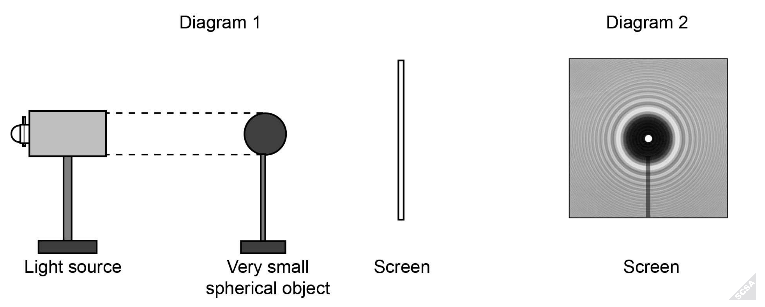
Example #1
An experiment was conducted to investigate the nature of light. A parallel beam of monochromatic light was directed at a very small spherical object and a white screen was positioned behind the object (Diagram 1). The pattern observed on the white screen is shown in Diagram 2. (Note: diagrams are not to scale.)
Discuss how the pattern in Diagram 2 was produced.
From this experiment, what conclusion can be made regarding the nature of light?
Notes:
This is known as the Arago spot (also the Poisson spot or Fresnel spot).

Slide 11
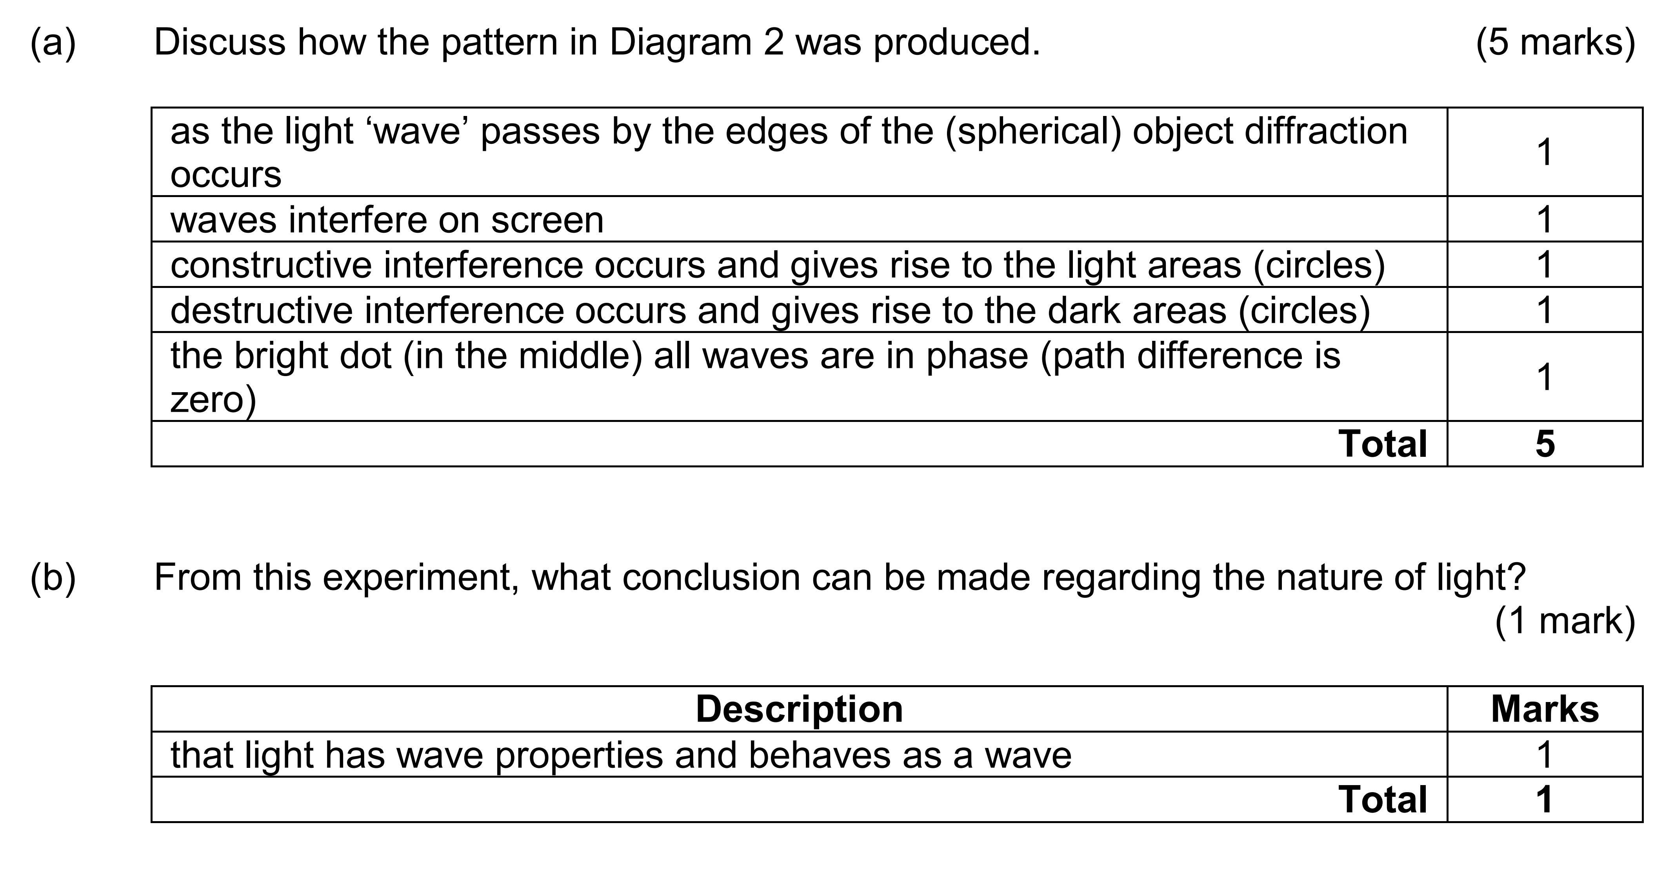
Example #1

Slide 12
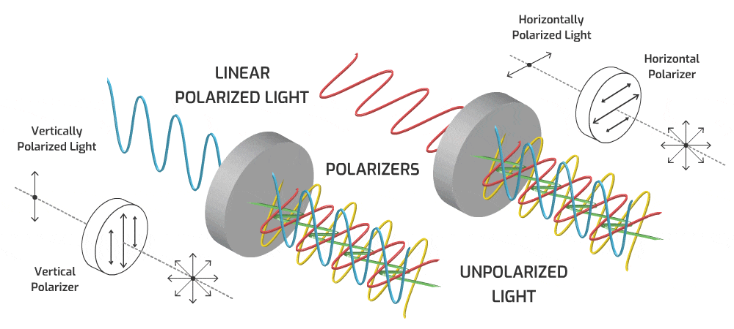
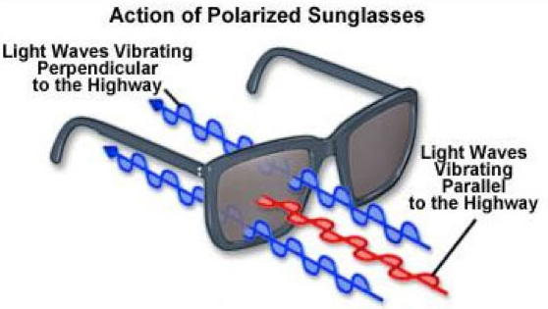
Polarisation
Most light sources produce unpolarised light: the disturbances in the electric field can be in any direction.
When a wave is only allowed to oscillate in a single plane, it is said to be polarised.
Light can be horizontally or vertically polarised.
Polarisation directly affects the electric field disturbances, so the magnetic field is not shown (though
it is also affected, just
indirectly).

